Slide 1



PolarGrid
Geoffrey Fox (PI) Indiana University
Associate Dean for Graduate Studies and Research, School of Informatics and Computing, Indiana University – Bloomington Director of Digital Science Center of the Pervasive Technology Institute
Linda Hayden (co-PI) ECSU

Slide 2
What is Cyberinfrastructure?
Cyberinfrastructure is infrastructure that supports distributed research and learning (e-Science, e-Research, e-Education or digital science at Indiana University)
Links data, people and computers
Exploits Internet technology (Web2.0 and Clouds) adding (via Grid technology) management, security, supercomputers etc.
It has two aspects: parallel – low latency (microseconds) between nodes and distributed – highish latency (milliseconds) between nodes
Parallel needed to get high performance on individual large simulations, data analysis etc.; must decompose problem
Distributed aspect integrates already distinct components (data)
Integrate with TeraGrid (and Open Science Grid)

Slide 3
Support CReSIS with Cyberinfrastructure
Cyberinfrastructure is distributed hardware and software supporting collaborative science
Base and Field Camps for Arctic and Antarctic expeditions
Training and education resources at ECSU
Collaboration Technology at ECSU
Lower-48 System at Indiana University and ECSU to support off line data analysis and large scale simulations installed and currently being tested (total ~ 20 TF)
CReSIS analysis suitable for clouds

Slide 4
Indiana University Cyberinfrastructure Experience
Indiana University PTI team is a partnership between a research group (Community Grids Laboratory led by Fox) and the University IT Research Technologies (UITS-RT led by Stewart)
This allows us robust systems support from expeditions to lower 48 systems with use of leading edge technologies
PolarGrid would not have succeeded without this collaboration
IU runs Internet2/NLR Network Operations Center http://globalnoc.iu.edu/
IU is a member of TeraGrid and Open Science Grid
IU leads FutureGrid – NSF facility to support testing of new systems and application software – Fox PI
IU has provided Cyberinfrastructure for LEAD (Tornado forecasting), QuakeSim (Earthquakes), Sensor Grids for Air Force in areas with some overlap with CReSIS requirements

Slide 5
5
Notes:
5

Slide 6
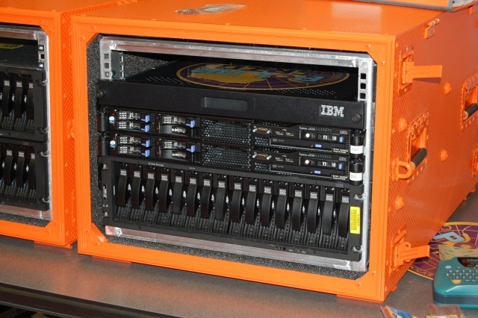
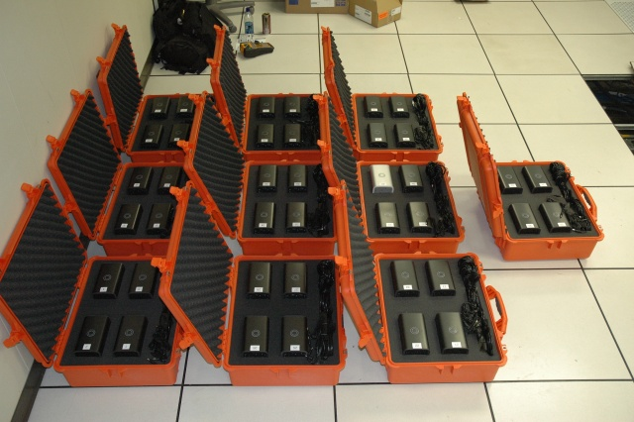
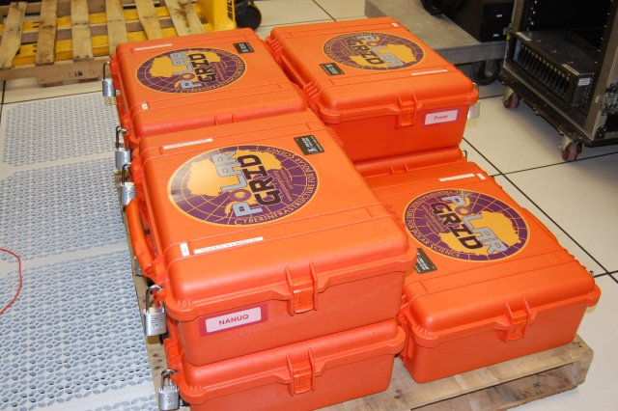

PolarGrid goes to Greenland
6
Notes:
6

Slide 7
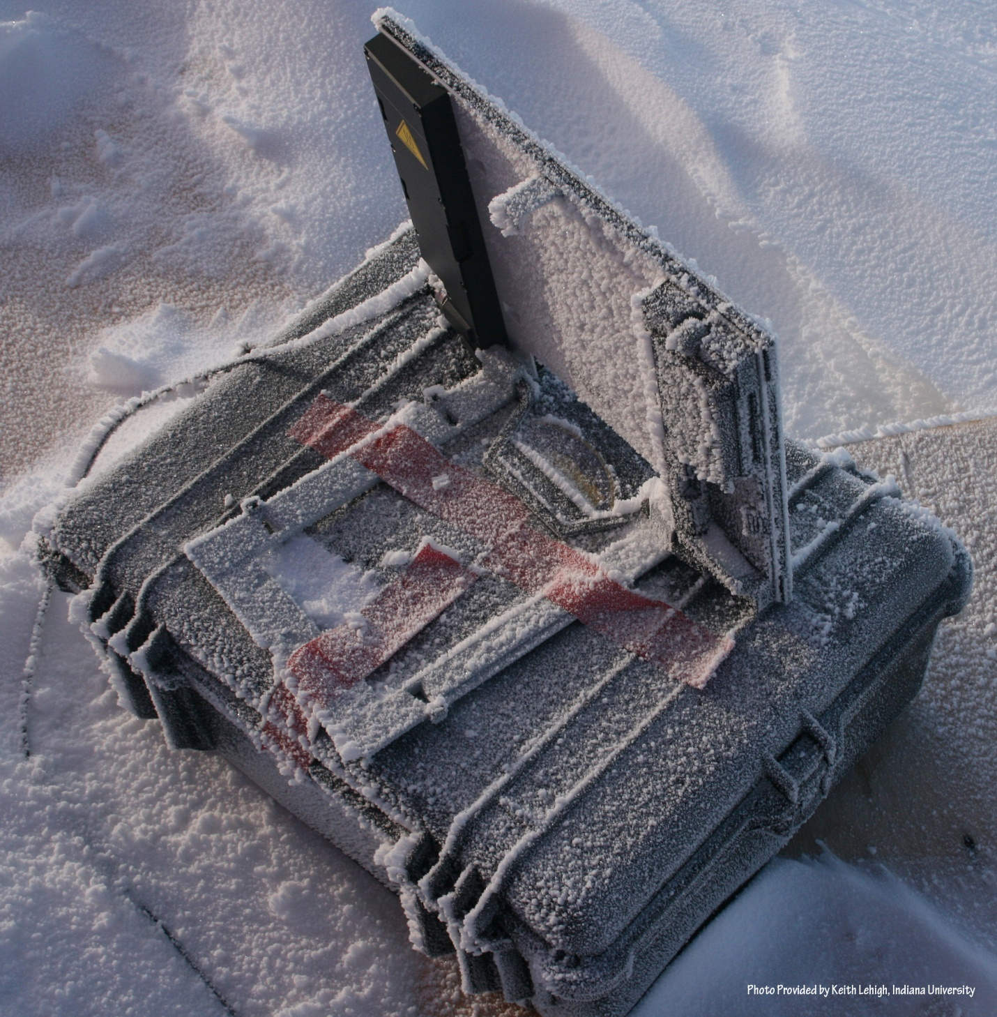
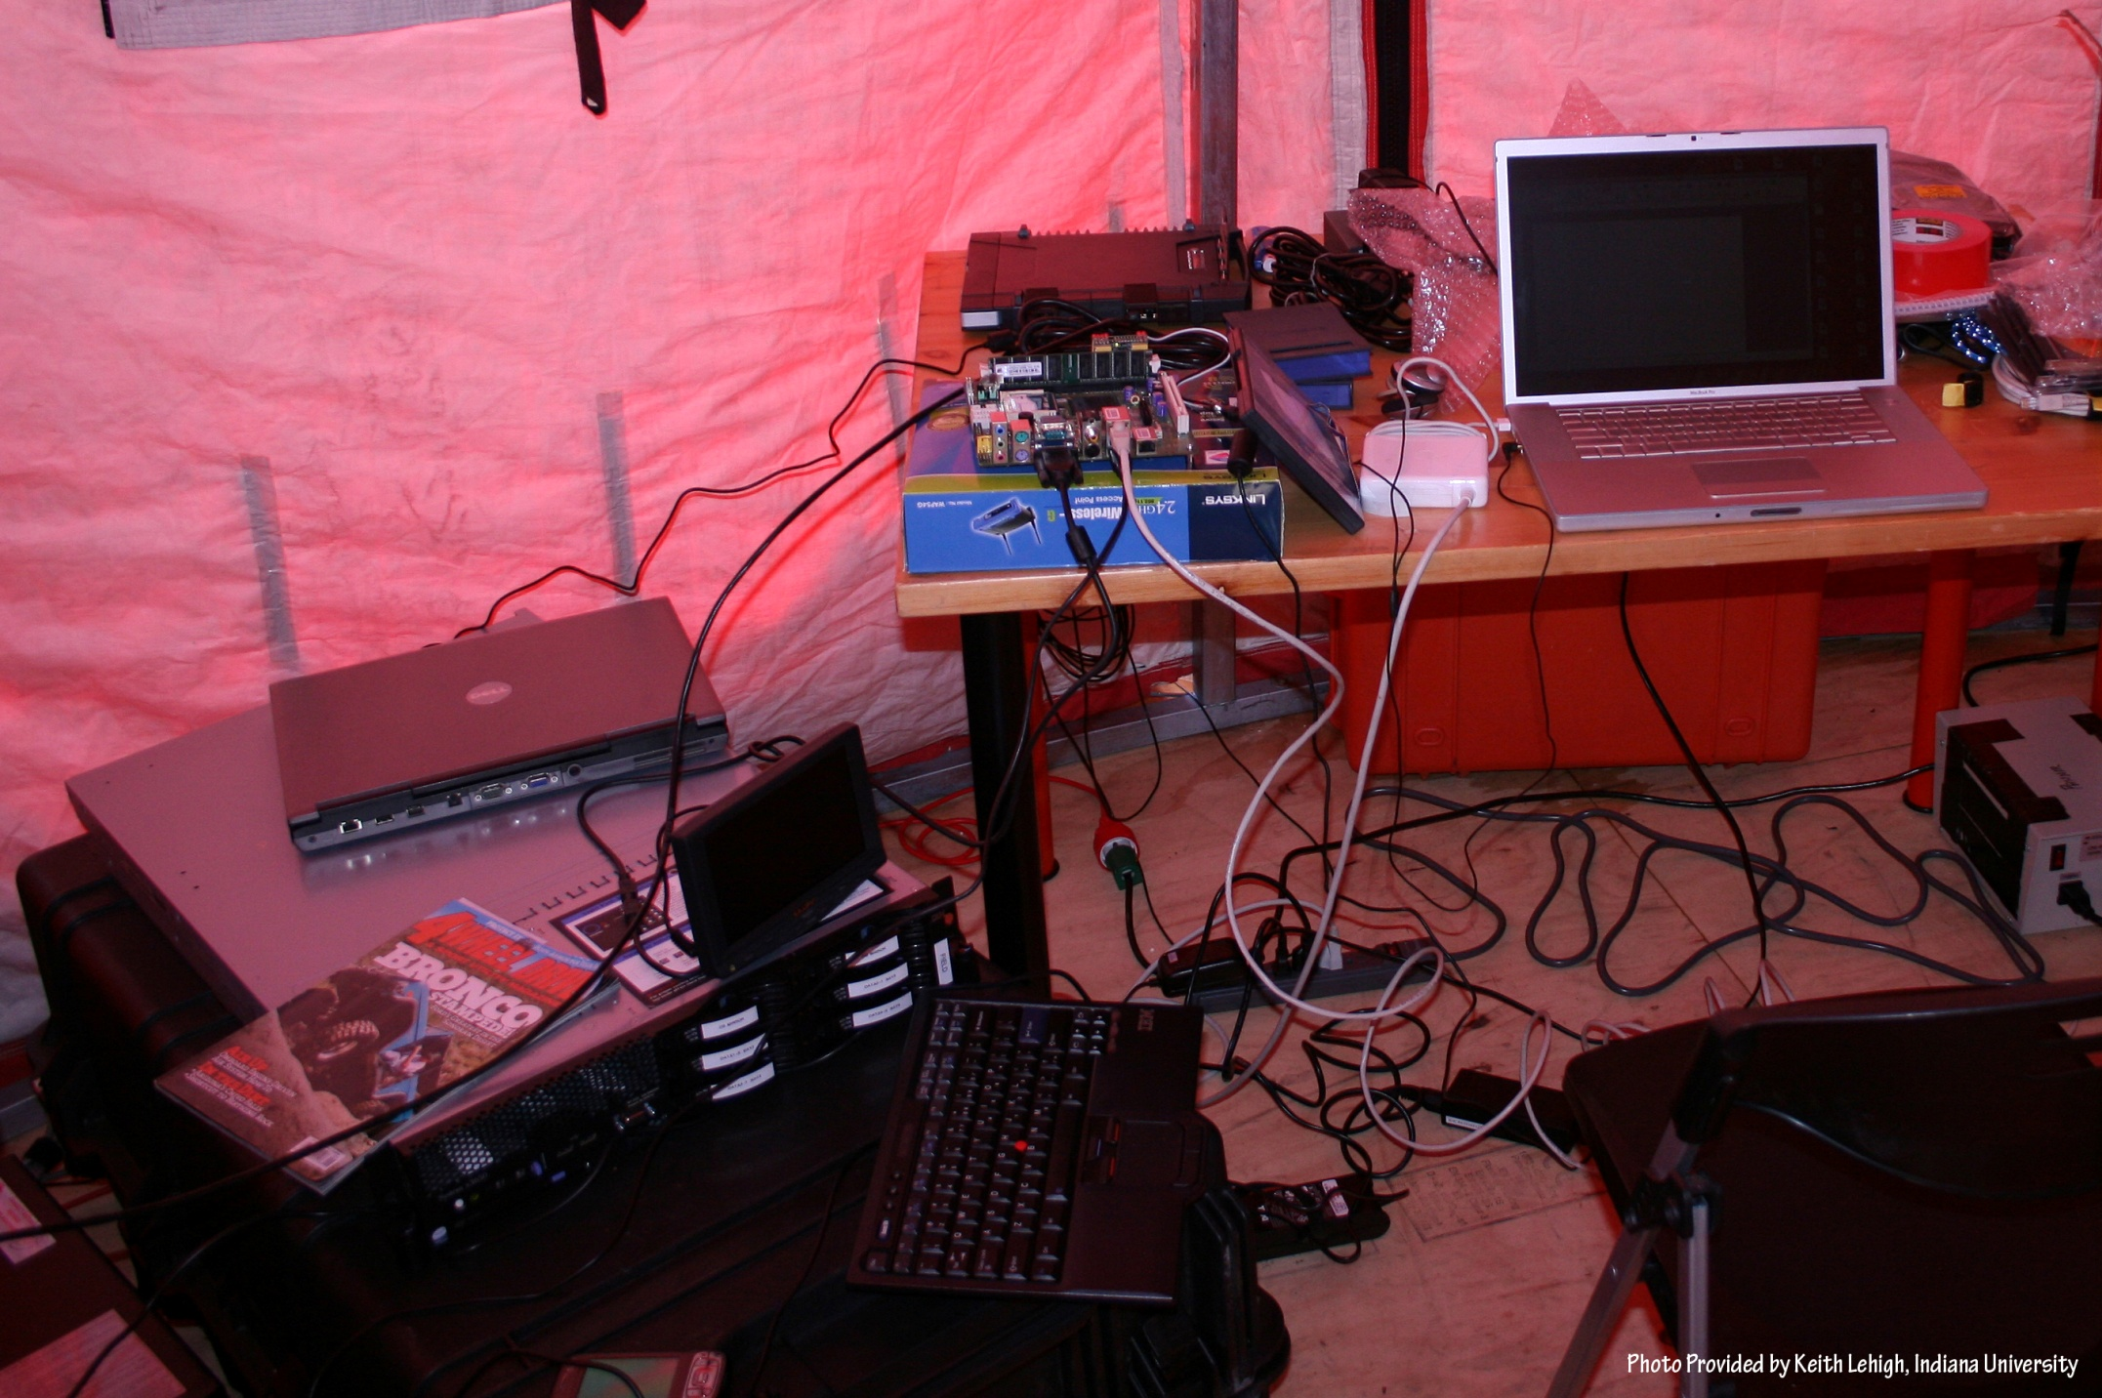
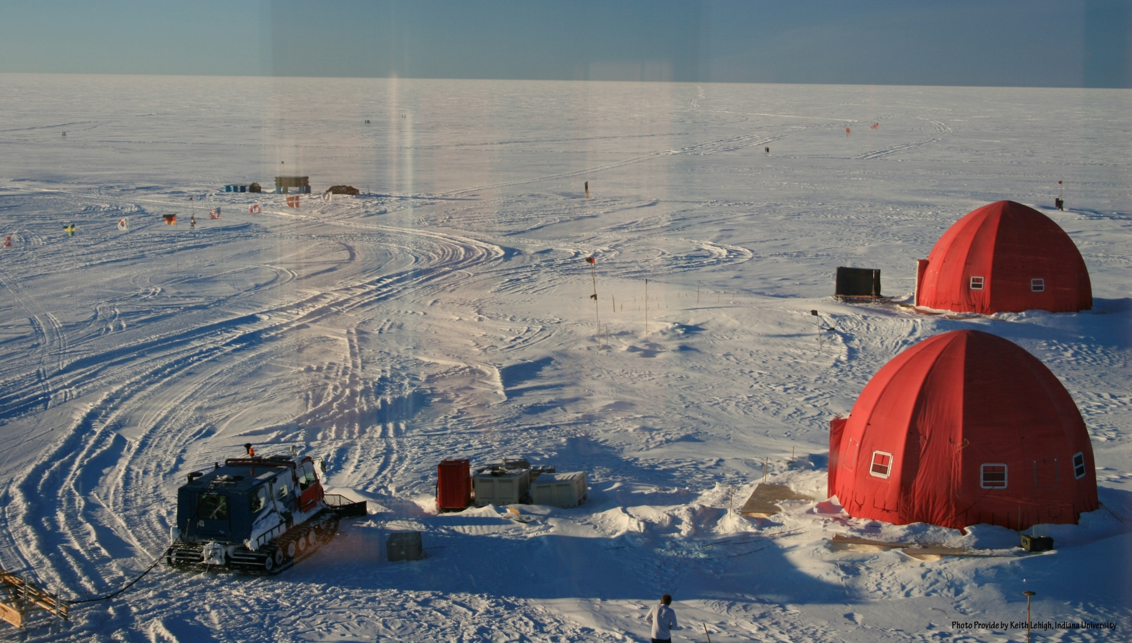
NEEM 2008 Base Station
7
Notes:
7

Slide 8
PolarGrid Greenland 2008
Base System (Ilulissat Airborne Radar)
8U, 64 core cluster, 48TB external fibre-channel array
Laptops (one off processing and image manipulation)
2TB MyBook tertiary storage
Total data acquisition 12TB (plus 2 back up copies)
Satellite transceiver available if needed, but used wired network at airport used for sending data back to IU
Base System (NEEM Surface Radar, Remote Deployment)
2U, 8 core system utilizing internal hard drives hot swap for data backup
4.5TB total data acquisition (plus 2 backup copies)
Satellite transceiver used for sending data back to IU
Laptops (one off processing and image manipulation)

Slide 9
PolarGrid Summary 2008-2010
Supported several expeditions starting July 2008
Ilulissat: airborne radar
NEEM: ground-based radar, remote deployment
Thwaites: ground-based radar
Punta Arenas/Byrd Camp: airborne radar
Thule/Kangerlussuaq: airborne radar
IU-funded Sys-Admin support in the field
1 admin Greenland NEEM 2008
1 admin Greenland 2009 (March 2009)
1 admin Antarctica 2009/2010 (Nov 09 – Feb 2010)
1 admin Greenland Thule March 2010
1 admin Greenland Kangerlussuaq-Thule April 2010

Slide 10
PolarGrid Summary 2008-2010
Expedition Cyberinfrastructure simplified after initial experiences as power/mobility more important than ability to do sophisticated analysis.
Smaller system footprint and data management has driven cost per system down.
Complex storage environments are not practical in a mobile data processing environment
Pre-processing data in the field has allowed validation of data acquisition during collection phases
Offline analysis partially done on PolarGrid system at Indiana University

Slide 11
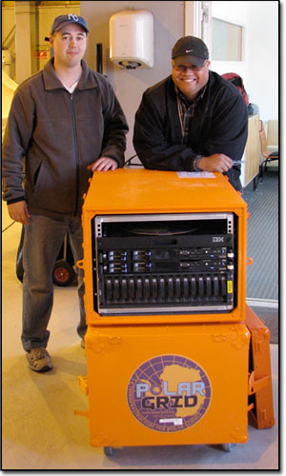
ECSU and PolarGrid
Initially a 64-core cluster, allowing near real-time analysis of radar data by the polar field teams.
Factor of 10 larger system being tested at IU and will be installed at ECSU
An educational videoconferencing Grid to support educational activities
PolarGrid Laboratory for students
ECSU supports PolarGrid Cyberinfrastructure in the field
Assistant Professor, Eric Akers, and graduate student, Je’aime Powell, from ECSU travel to Greenland 2008
11 0f 12
Notes:
11

Slide 12
Possible Future CReSIS Contributions
Base and Field Camps for Arctic and Antarctic expeditions
Initial data analysis to monitor experimental equipment
Training and education resources
Computer labs; Cyberlearning/collaboration
Full off-line analysis of data on “lower 48” systems exploiting PolarGrid, Indiana University (archival and dynamic storage), TeraGrid
Data management, metadata support and long term data repositories
Parallel (multicore/cluster) versions of simulation and data analysis codes
Portals for ease of use

